Slide 1
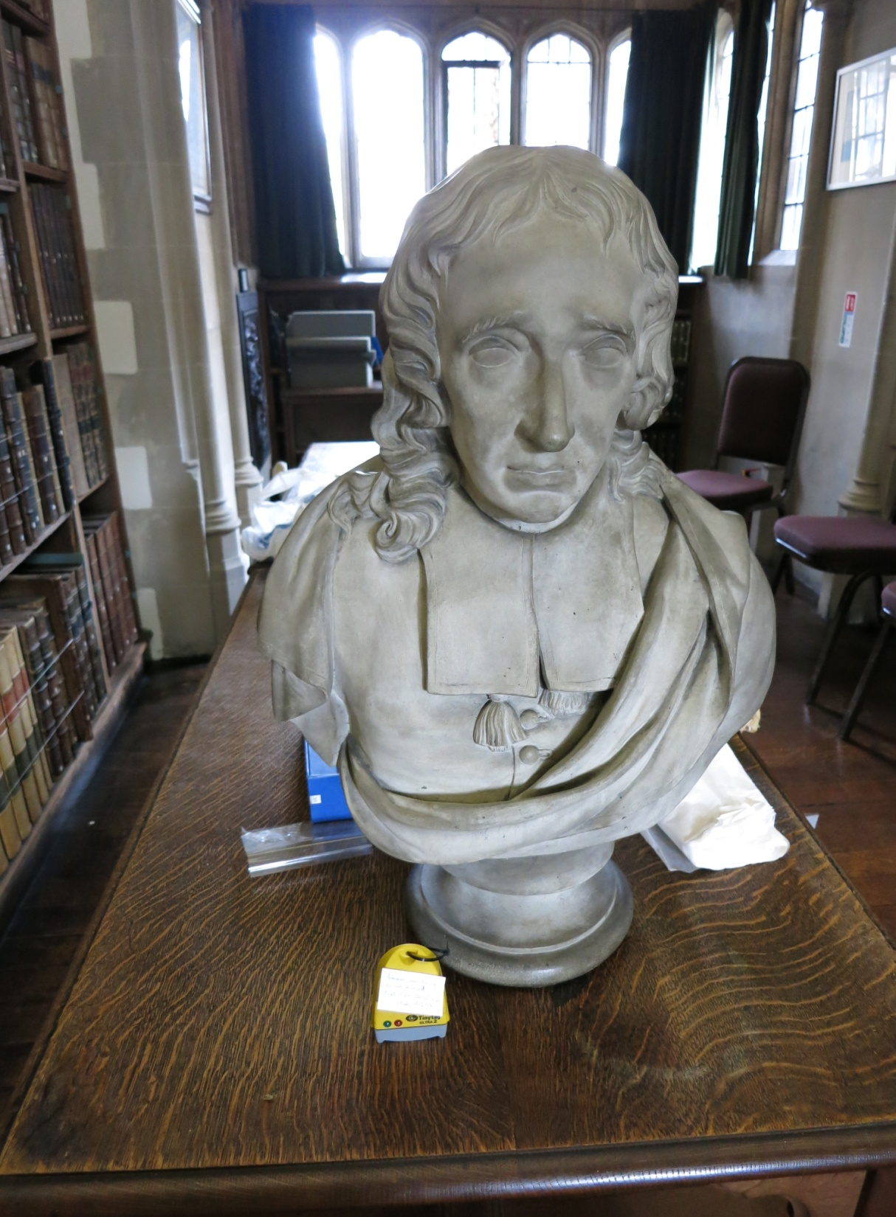
Preparation, practice and lessons learnt:
before and after the Old Library flood at Christ’s College, July 2015
James Smith
Charlotte Hoare

Slide 2
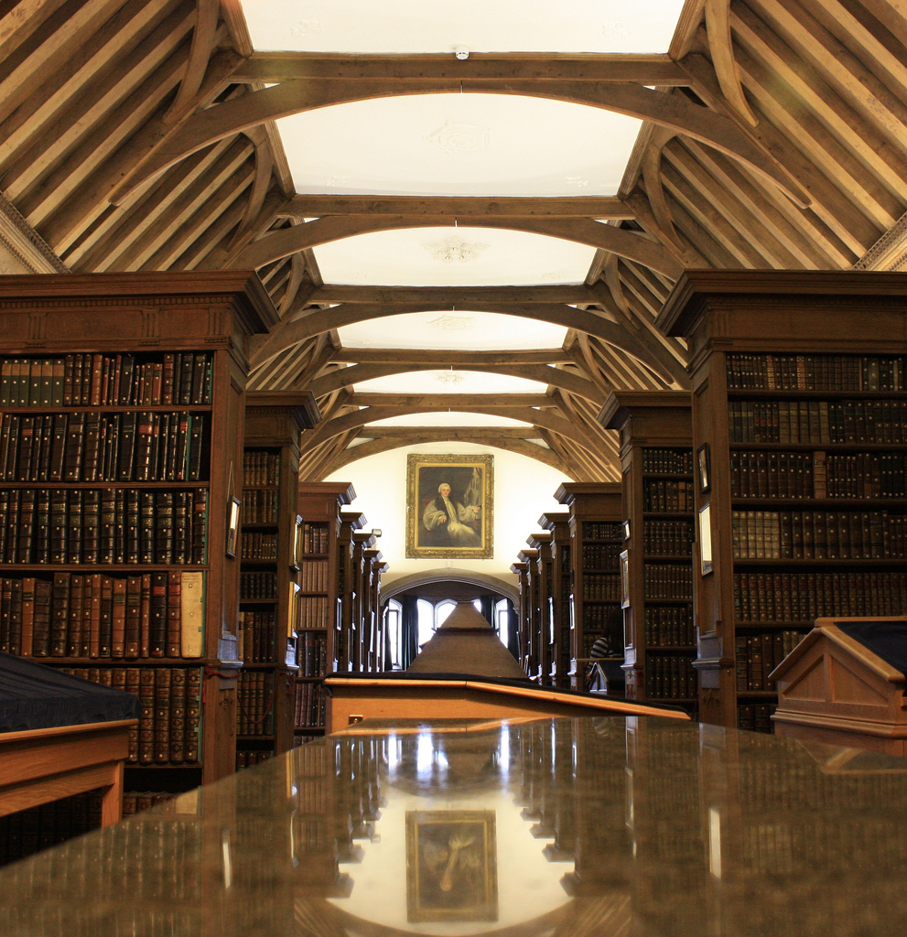

Slide 3
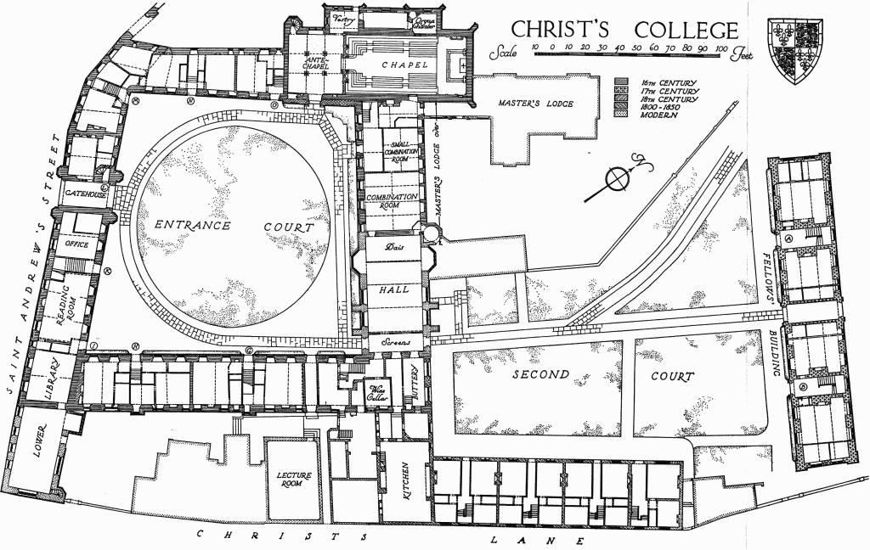

Slide 4
Disaster preparedness
Change of staff/modification of Old Library’s function prompted re-appraisal
Greater liaison with College Maintenance department to produce a more thorough plan
Wider distribution of disaster plan within College

Slide 5
The disaster
17 July 2015
Cambridge hit by torrential rains
Discovery
Extraction of affected books (308) to ‘airing/drying rooms’
Identification of books requiring freeze-drying treatment by CCCC
Removal of isolated books by Harwell for freeze-drying
Dehumidification of Old Library
18 July – 4 August 2015
Continued 24-hour monitoring of humidity of Old Library with assistance from night porters

Slide 6
The disaster
23 September 2015
Return of freeze-dried books from Harwell
2 October 2015
Assessment of books returned from Harwell by external conservator: 26 removed in order to undertake conservation work
December 2015
Return of conserved books from external conservator
Production of report for submission to Library Committee and Finance Department

Slide 7
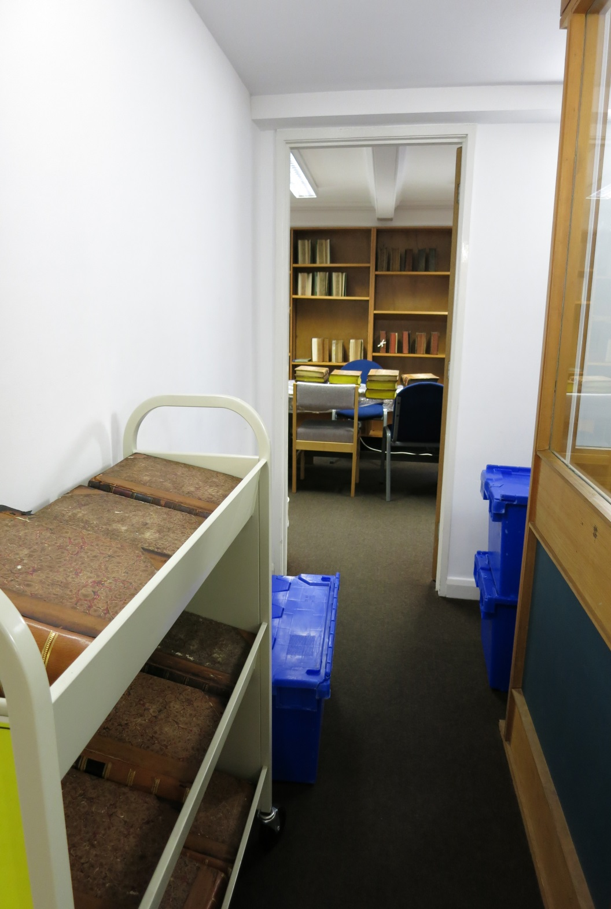

Slide 8
Lessons learnt #1
Disaster plans work!
Structure, schedule and prioritisation - easily forgotten in the heat of the moment
Deal with the nitty-gritty
Be familiar with the practicalities

Slide 9
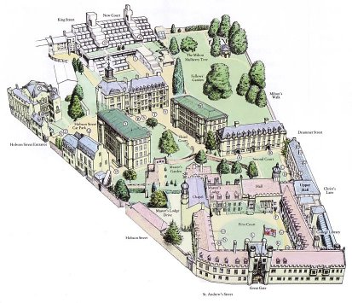
Lessons learnt #2
Importance of liaison with the wider organisation
Interdependence with the rest of College
Awareness is not the same as comprehension
On the day: disaster is unlikely to be isolated to the Library

Slide 10
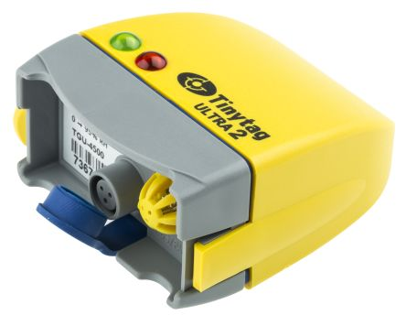
Lessons learnt #3
Longer term considerations
Disaster ‘fall out’: budgets and conservation
Environmental monitoring
Follow up on specific issues

Slide 11
Top tips
Before
Take photographs and visit locations
Integrate disaster plan into staff induction procedures
Consider ready-made templates to keep track
Know what is ‘normal’
Consider what resources might be stretched across an institution in the event of a disaster
During
Quick discovery
Salvage areas – close, secure, available for prolonged period
After
Keep your institution involved
Update plans as soon as possible

