Slide 1
Staging a disaster simulation exercise with the Fire Service
Sarah Lewery
Conservator
Churchill Archives Centre

Slide 2
Testing our Disaster Contingency Plan
Churchill Archives Centre has regular staff training but there is a need to test the Plan periodically
First one 2007
Second one 2015 – Exercise Winston

Slide 3
Lessons learnt 2007
The Disaster supplies cupboard was in the wrong place, being in another part of the same building as the incident. Since re-located
There was some confusion over keys provided by the duty porters – completely full set now stored with the porters
The Fire service (in the dark and with breathing apparatus on) needed extra guidance on which were our priority shelves. We have now clarified this by better labelling of bays.
Fire Service noted the importance of fluorescent vests to identify Archives Centre Incident managers with whom they should be communicating.
On the advice of the Fire Service, we purchased face masks (as well as gloves) for the salvage team (in event of smoke damage) and better, heavy duty gloves for our disaster supplies cupboard.
It was incredibly tiring for the salvage team moving c.200 boxes through college to the operation area, while wearing masks! This illustrated the importance of breaks.
Notes:
The Disaster supplies cupboard was in the wrong place, being in another part of the same building as the incident. The DRC had to retrieve supplies from there after permission from the Fire Service and with them in tow, so it was a bit of a rush. We are moving the cupboard to another part of college. We did consider the idea put forward by the Fire Service afterwards of a Gerda box (secure information box) but decided against it as we have 24 hr porter cover with safe etc.
There was confusion over keys – as the DRC handed over the full set stored in the safe at the Porters Lodge – but the general key was not in there as this was thought to be available from porters and archive staff – but it did add confusion at the time. We have now a completely full set of keys in the Porters safe.
The Fire service (in the dark and with breathing apparatus on) needed extra guidance on which were our priority shelves. We have now clarified this by better labelling of bays.
Fluorescent vests are important for the DRC/deputy DRC as the Fire Service need to know who are the leaders of the team that they should communicate with.
There was discussion about the Porters Lodge improving things at their end, with walkie-talkies and fluorescent jackets – I’m not sure if they acted on this.
Fire Service were helpful in suggesting use of face masks (as well as gloves) to the salvage team (because of smoke damage to boxes). Also suggested better, heavy duty gloves for our disaster box
It was incredibly tiring for the salvage team moving c.200 boxes through college to the operation area, wearing masks! Importance here of breaks.

Slide 4
The Fire Service – testing their salvage capability
The Cambridgeshire Fire and Rescue Service were looking particularly at their salvage capability and wanted to organise a salvage exercise, involving 4 - 6 fire appliances.

Slide 5
Exercise Winston - the scenario
The scenario we’d agreed ahead with the Fire Service was that there had been a fire in our storage area that had been put out by our gas fire suppression system, but there was damage to the roof and the room was filled with smoke. It was also out-of-hours, so everything was securely locked up and alarmed as normal – and it was a cold, dark winter’s night in February.

Slide 6
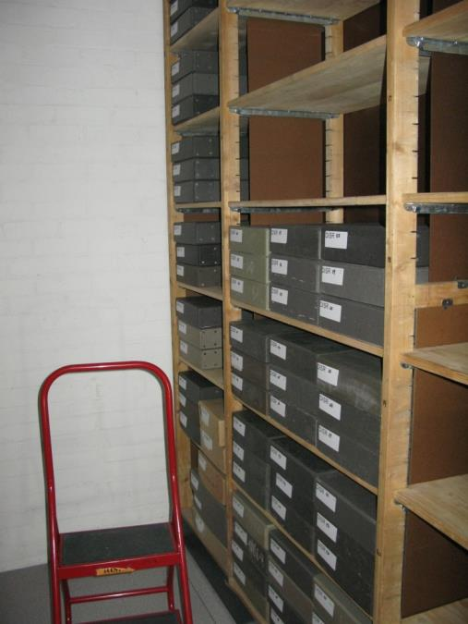
Preparation
Consulted extensively with Fire Service and carried out risk assessment for the event.
We had prepared 280 filled dummy priority boxes (many heavy) and temporarily updated the Disaster Contingency Plan with this information
Stationed a staff member within the dark, locked, alarmed storage area to remain there during the whole operation to ensure only the correct boxes were taken out. But not to be involved unless absolutely necessary!
Notes:
Alarms set off by DR. Call Centre will be informed by DR ahead that it's a drill, but will call through to Fire Brigade
Porters on duty should:
Also call the Fire Brigade?
Call first person on Archives Call Out Rota (probably SL, who will call AP at home)
Walk across to Archives Centre to see if there is any sign of fire. They will find SL in the building who will inform them that this is a drill but that we are playing it for real and to carry on as if there is a real fire incident (and not to silence the alarms) They will liaise with the second porter who should tell them that the fire brigade are on the way and to open up the fire road. Ideally porter will stay at fire road to guide the first appliance.
On arrival at Lodge, porter should hand over CAC Disaster Plan and respond to questions from Fire fighters.
Deal with evacuation of students etc from Library and Archives Block (who will be informed very quickly that it's a drill)
Fire fighters arrive at back of CAC (some may walk round the building from the Lodge first - not sure) Initially it will be two appliances and a rescue vehicle, but later up to 8 crews/appliances in total - 5 people per crew.. SL and other staff will be stationed at CAC but not involved in the operation until Allen arrives on call out.
By then, they may be wanting to get into the Strongroom as the idea is that there was a real fire, but the inergen has held it back for 10 mins but they want to get in there in case it reignites later. Also they want to evacuate the priority material as there is smoke and risk of further fire…..There will be no lights and the fire alarm bells will sound throughout the whole operation - possibly for up to an hour until the fire service inform us that they have made the area safe and smoke has dissipated...

Slide 7
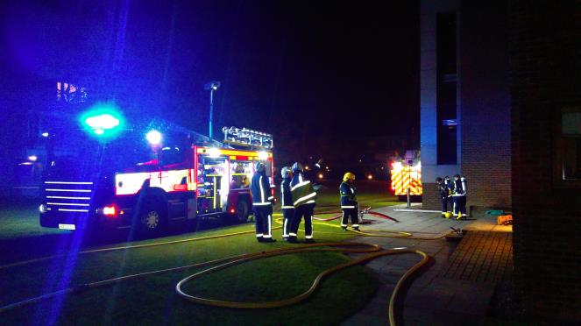
Exercise Winston
7pm on a Tuesday evening in February 2015
College life going on a normal, including students using the library (same building as the Archives)
Certain key staff aware but the porters on duty had no idea that this was a drill and so responded as if it were a real incident, assisting the five fire crews, from different regions, as they arrived in their vehicles a few minutes later, and calling out Archives Centre staff.
The four senior members of the staff who would act as the incident managers in a real event, were involved.
Notes:
Image – fire service soon after arrival, getting hoses ready and assessing situation

Slide 8
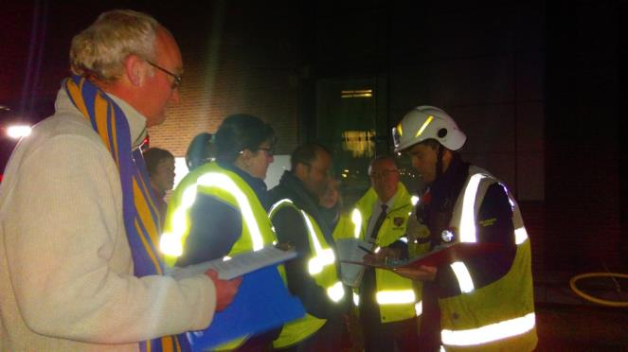
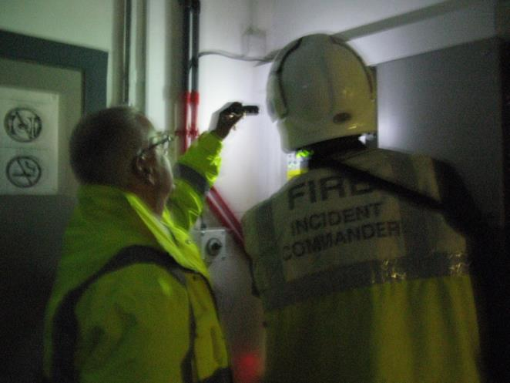
Practising the Archives Centre Disaster Plan
We wanted to test the incident assessment and reaction of our management team
And also the reaction of the first responders – duty porters.

Slide 9
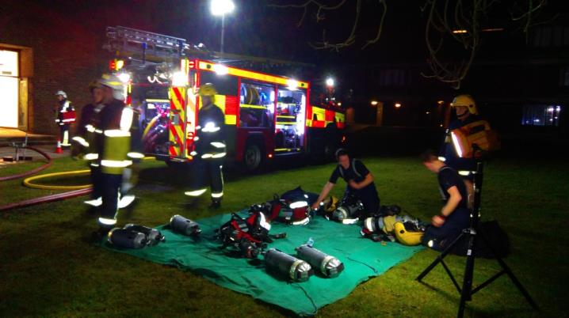
The Salvage
For the fire crew commanders, this was a carefully planned training event involving crews from Cambridge, St Neots, Gamlingay, Linton and Royston.
It tested their ability and co-ordination in assessing the situation, stabilising it and evacuating the priority material identified in the Archive Centre’s Disaster Contingency Plan.
The priority boxes had to be moved by the fire-fighters, wearing heavy breathing apparatus, to a secure area while keeping them safe at all times.
Notes:
Image Fire fighters putting on breathing apparatus

Slide 10
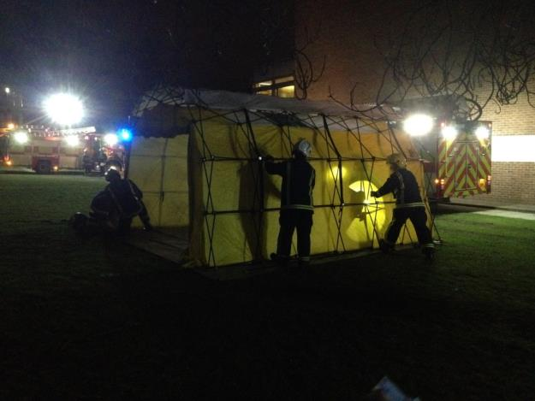
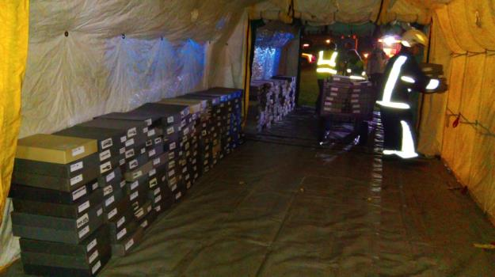
The crews set up a protected, covered area outside the building to take the material to before moving it to another building.

Slide 11
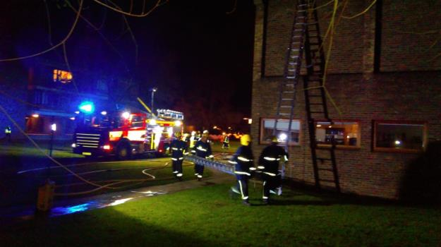
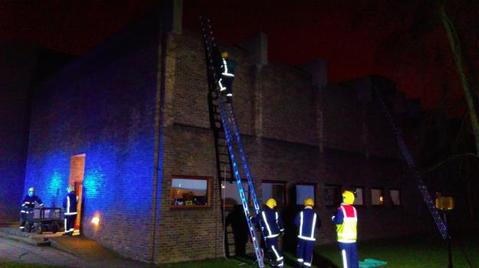
While this was going on, another crew were using long ladders to access the roof in order to cover it with heavy duty sheeting to protect the storage area from the elements.

Slide 12
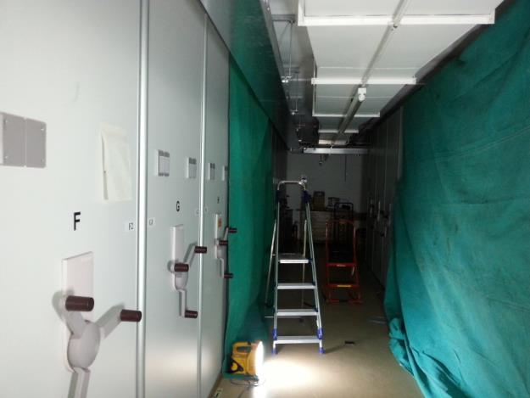
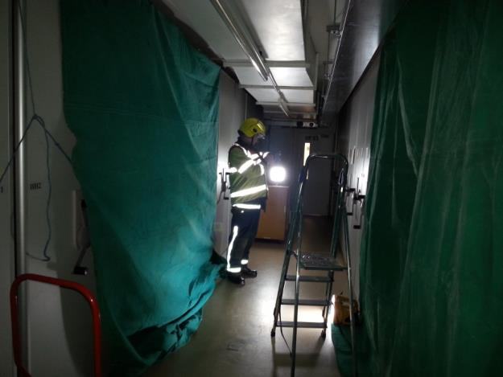
Inside the store, other fire-fighters were sheeting up the shelving directly underneath the hole in the roof to protect the archives still in the room.

Slide 13
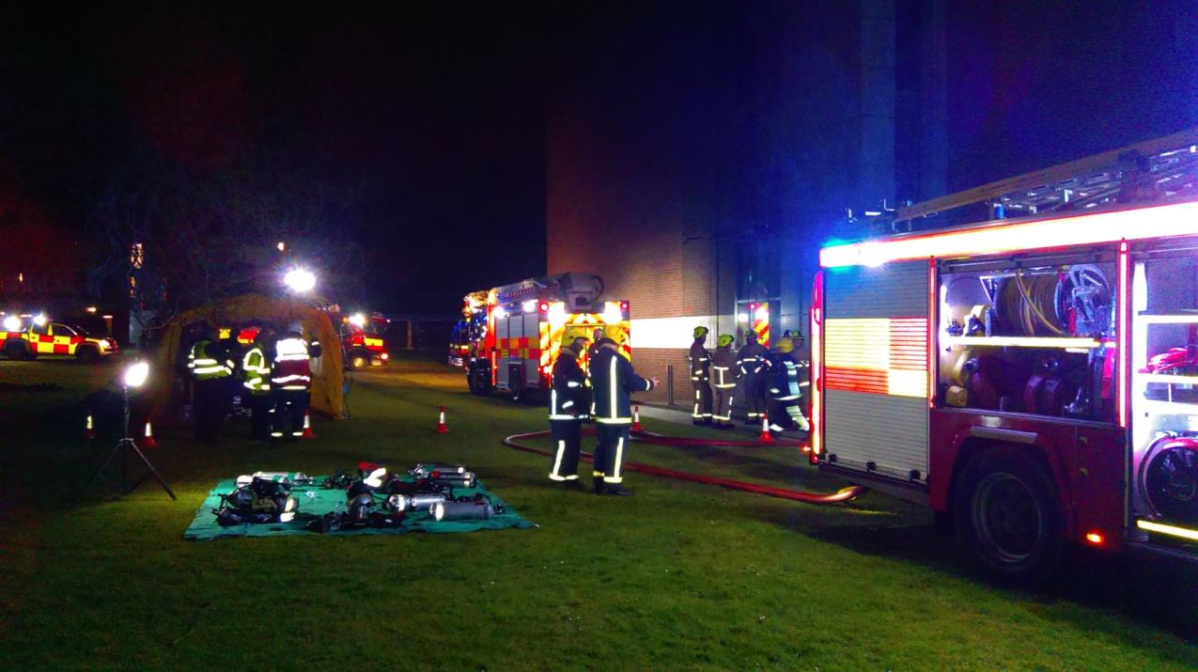
In full swing!

Slide 14
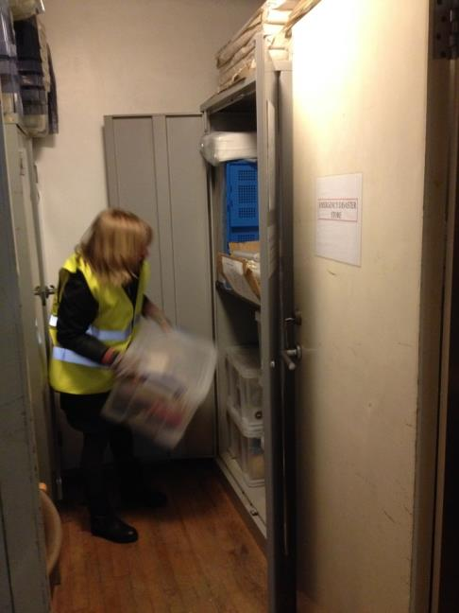
Assisting the salvage
We looked on, offering advice and help to the crews to enable access to the secure areas and identification of the priority collection.
We prepared the temporary storage area identified in our Plan, using equipment and materials stockpiled in our emergency disaster supplies cupboard.
Notes:
Document tracking forms, pencils, sheeting for floor, fluorescent jackets

Slide 15
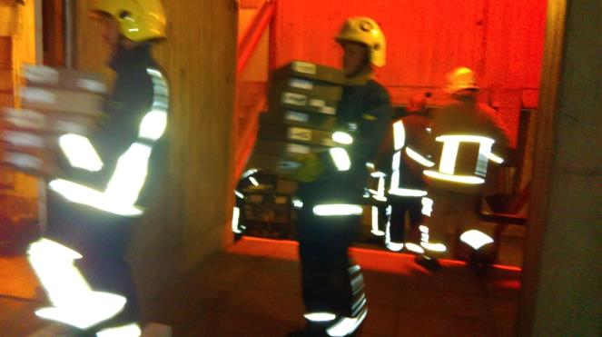
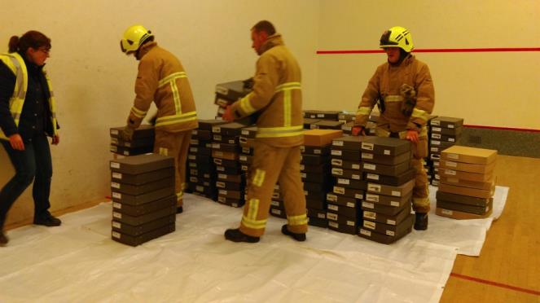
Moving priority boxes to temporary accommodation

Slide 16
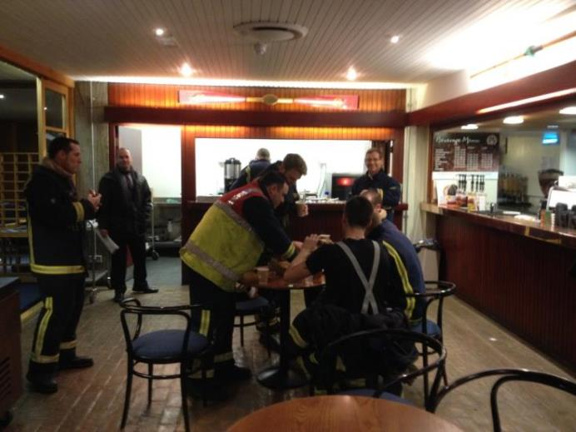
The end of the exercise
Nearly two and a half hours later, the fire crews had stabilised the areas and moved the priority material to the temporary storage area. They were exhausted and we were high on adrenaline!
The College had arranged for refreshments to be laid on in the buttery for anyone that needed them at any point throughout the exercise. A few of the fire-fighters took a well earned cuppa at the end of the exercise and all seemed to have had a fruitful and even enjoyable time.

Slide 17
Outcomes
We decided that it would be useful to add a laminated ‘front sheet’ to our Disaster Contingency Plan held in the Porters Lodge – for use by the Fire Service
The main problem encountered was the Fire Road…
Notes:
Show ‘front sheet’ in hard copy. No longer have ‘risk card’. Plastic mesh in the ground

Slide 18
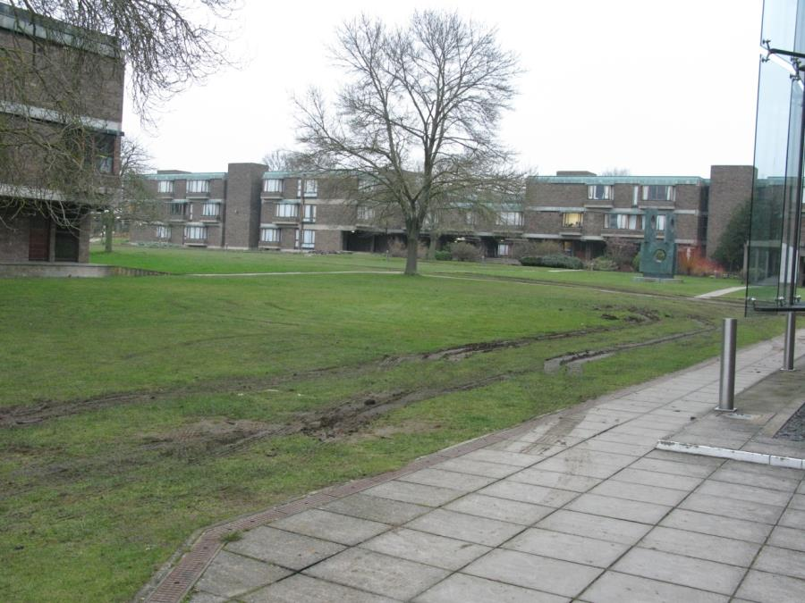
The aftermath – and the biggest lesson learnt!
Notes:
Currently looking at ‘groundtrax’ and have done a short section in this but not all of it. Also needs widening and edges marking for dark nights.

